Slide 1
Body Fluid Analysis

Slide 2
Body Fluids
Body fluids will be discussed : •
Cerebrospinal,CSF .١
Serous (pleural, peritoneal, pericardial), .٢ Synovial fluids. .٣

Slide 3
Preanalytical Variables, anticoagulant
The type of anticoagulant used for the •
collection of specific body fluids may also affect test results.
eg, using an additive when it is not required •
(cerebrospinal fluid) may possibly affect
the enumeration of white and red blood cells. Using the wrong additive (synovial) could possibly •
introduce artifacts and therefore interfere with the identification of cellular elements present on a
slide.

Slide 4
Preanalytical Variables
In some body fluids, the proper order of draw is •
important (the incidence of cellular contamination from tube to tube is reduced).
It is also necessary so that a microbiology specimen is not • contaminated.
In addition, hemolyzed and clotted specimens are not • recommended as specimens of choice for analysis
However, circumstances may arise when it is not • possible to acquire another specimen from a patient.

Slide 5
Preanalytical Variables
Specimen transport may be affected, eg, the • temperature at which a specimen is transported could
affect the integrity, degradation, or deterioration of the constituents of the fluid.
The transport time must also be acceptable to maintain • specimen integrity.
The method of transport may also affect the integrity of • the specimen.
For example, the use of a pneumatic tube system must • be approached with caution because excessive shaking of body fluids may result in a breakdown of the cellular
^{constituents.}

Slide 6
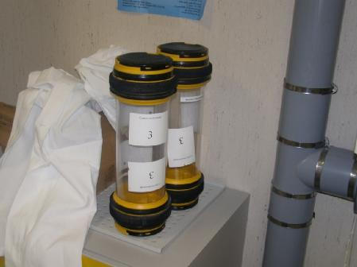
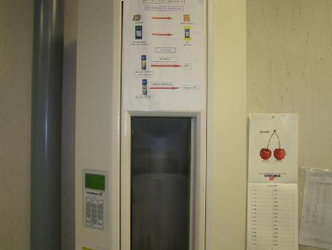
Pneumatic System

Slide 7
Preanalytical Variables
The date and time on the specimens should be verified against the actual collection time of the specimen.
If a significant discrepancy between the times exists, the unit
should be notified to rectify the discrepancy before test
analyses.
If these specimen identification guidelines are not met either electronically or manually, the unit will be notified
that a new specimen will be required.
If specimen identification guidelines are not met, the
laboratory personnel must follow the administrative guidelines of the laboratory for analysis or rejection of the
specimen.
In addition, a Laboratory Incident Report should be filed.
These specimens should be received with •
proper identification.
Label should include: •
The name of the patient, .١
The medical record number, .٢
The accession number, .٣
The location (unit), .۴
The date and time of specimen collection, and .۵
The list of the tests ordered. .۶

Slide 8
Specimen Collection
Cerebrospinal Fluid, CSF

Slide 9
Specimen Collection
Cerebrospinal Fluid, CSF
CSF is usually collected by lumbar puncture(LP), but may also be obtained by lateral cervical or cisternal puncture. Sterile technique is mandatory to avoid introducing
bacteria.
Manometric measurements may be done and are the responsibility of the clinical service rather than the
laboratory.
Usually, fluid is collected into three or four tubes for
chemical, microbiologic, and cellular analysis. The tubes should be labeled according to the sequence
of collection.
•
•
•
•
•

Slide 10
Specimen Collection
Cerebrospinal Fluid, CSF
It is preferable to have the first tube analyzed for chemical and serologic studies.
Subsequent tubes should be used for microbial and cellular analysis to obtain accurate cell
counts and decrease the chance of bacterial contamination.
No anticoagulant is necessary, since spinal fluid
does not clot except occasionally if the puncture is traumatic.
•
•
•

Slide 11
Specimen Collection
Cerebrospinal Fluid, CSF
Since the volume of CSF is relatively small, the total amount collected is limited and usually
varies from 10 to 20 mL in adults. Up to 8 mL may be safely removed from the
smallest infant.
Complications of lumbar puncture include
headache, infection, and brain herniation. Rarer complications may also occur.
•
•
•
•

Slide 12
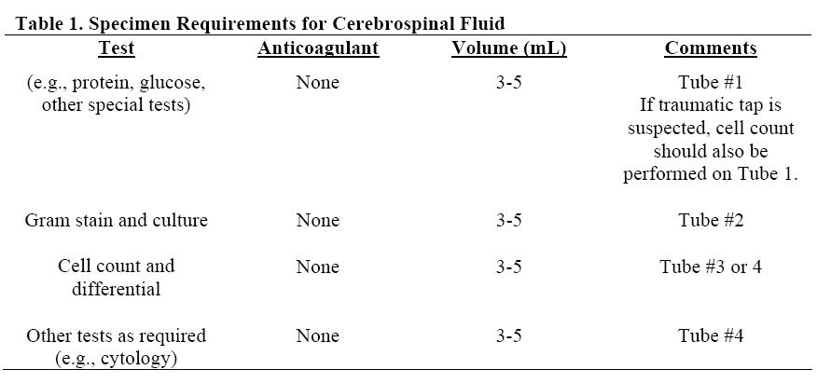
Specimen Collection
Cerebrospinal Fluid, CSF

Slide 13
Specimen Collection
Serous Fluid

Slide 14
Specimen Collection
Serous Fluid
Serous fluids (e.g., pleural, peritoneal) from large volume collections may be aliquoted into smaller volumes before
transport to the laboratory or in the laboratory.
Specimens should be gently agitated during collection, before aliquoting, and before testing for cell counts and differentials.
EDTA is the recommended anticoagulant for cell counts and differentials.
Refrigerated storage is adequate for cell counts and differentials for up to 24 hours.
Although testing can be done on small volumes of fluid, 5 to 8 mL is recommended in the event follow up studies are needed
(e.g., flow cytometry). A sterile collection tube must be used for microbial studies.
•
•
•
•
•
•

Slide 15
Specimen Collection
Serous Fluid
For cytology specimens, a wide range of volumes • may be sent to the laboratory.
As little as 15 to greater than 100 mL may be sent • for analysis.
A 50-mL specimen is recommended. • Sterility is not required and no anticoagulant is •
necessary. However, heparin and EDTA are also used. •
If clumps of material are present, they can be • processed as a cell block.

Slide 16
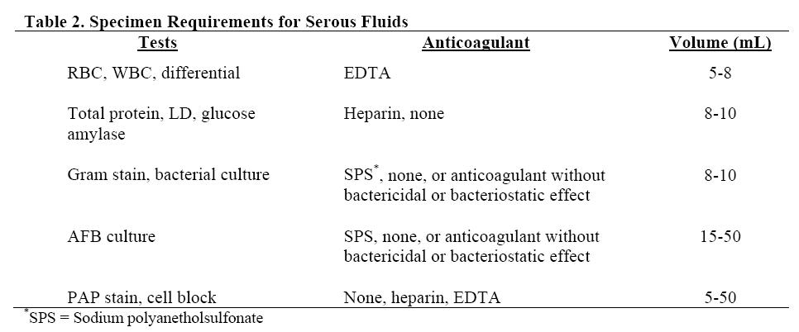
Specimen Collection
Serous Fluid

Slide 17
Specimen Collection
Synovial Fluid

Slide 18
Specimen Collection
Synovial Fluid
The amount of fluid depends on the size of the • joint and effusion.
A 3- to 5-mL sample is ideal for laboratory analysis. •
(However, since this may not be possible in smaller joints,
the physician should prioritize the requested tests and clearly communicate with the laboratory.)
Specimens should not be rejected because of •
small volumes, since even a drop may provide definitive diagnosis in crystalline joint disease and only small volumes are needed for cell count and
differential.

Slide 19
Specimen Collection
Synovial Fluid
The on the collection tray, previously used to • remove fluid from a medicinal vial.
Fluid should be thoroughly mixed after collection • and before analysis in the laboratory to obtain
accurate cell counts. Some texts indicate that lithium heparin and EDTA •
should not be used as anticoagulants because they produce crystalline material that can be confused
with pathologic crystals.
However, others have used lithium heparin and • EDTA without difficulty.

Slide 20
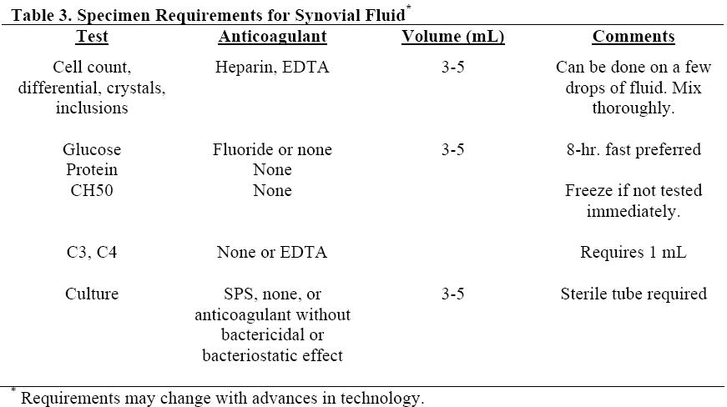
Specimen Collection
Synovial Fluid

Slide 21
Specimen Handling and Transport

Slide 22
Specimen Handling and Transport
Specimens should be transported to the • laboratory promptly.
Cellular degeneration of CSF can begin within •
one hour of collection, so cell counts should be completed as soon as possible.

Slide 23
Specimen Handling and Transport
CSF specimens should be transported at • ambient temperature to the testing site as
soon as possible following completion of the collection procedures.
CSF for microbiology testing should never be •
refrigerated before or after transport; since
some organisms are fastidious and
temperature sensitive, they have the
capability of becoming nonviable.

Slide 24
Serous Fluids
It is also recommended that pleural, pericardial, and
peritoneal fluids be transported to the testing site at ambient temperature.
To preserve the integrity of these specimens, however, the testing site should be in receipt of these specimens as soon as possible after the completion
of the collection procedures.
Otherwise, cell lysis, cellular degradation, and bacterial growth could occur and possibly affect the
test results.
•
•
•

Slide 25
Serous Fluids
Serous fluids for the cytology laboratory should be sent as soon as possible.
If storage is necessary, the specimen should be refrigerated at 4 °C without a fixative.
Serous fluids have a high protein content,
cellular detail with Papanicolaou (PAP), H & E, or other stains will be adequately preserved
with refrigeration for several days.
•
•
•

Slide 26
Synovial Fluids
Synovial fluid specimens may be transported • and analyzed at room temperature.

Slide 27
Quantitative Assessment
Manual Counting, Procedure

Slide 28
Quantitative Assessment
Manual Counting, Procedure
Mix the specimen well by rotation on an automated mixer for a maximum of 2 to 5 min. (excessive rocking may damage cells) or hand mix by inverting the tube 10
to 15 times.
The exception is synovial fluid, which must be mixed for 5 to 10 min due to the viscosity of the fluid.
If the fluid is in a conical tube, flick the bottom of the conical tube several times to dislodge cells before mixing
the specimen.
The more turbid the sample, the greater the mixing process impacts cell count accuracy.
•
•
•
•

Slide 29
Specimen Dilutions
The sample should be well mixed before • analysis.
Both erythrocytes and nucleated cells are • enumerated in the same chamber.
Specimens are usually counted undiluted, • unless they are bloody or cloudy.
Typical dilutions for any fluid can range from •
1:10 to 1:200 or higher, depending on the turbidity of the specimen.

Slide 30
Specimen Dilutions
Different diluents can be used to dilute the fluids.
Isotonic saline can be used for both white and red cell dilutions while acetic acid or hypotonic saline may be
used to lyse red cells for white cell dilutions.
Acetic acid should not be used as a diluent for synovial fluid manual nucleated cell counts, since mucin will
coagulate.
If manual nucleated cell counts are performed on synovial fluid samples, erythrocytes can be lysed, with preservation of nucleated cells, by using a hypotonic
saline solution (0.3%).
•
•
•

Slide 31
Hemacytometer Preparation and Charging
Before charging the hemacytometer chamber, make sure it is clean and dry. Place a coverslip on the hemacytometer.
Place the hemacytometer in a petri dish lined with moist paper. Elevate the hemacytometer on two sticks so it does not come in direct contact with the
moist paper.
Fill both sides of the hemacytometer, being careful not to overfill. After the hemacytometer is loaded, allow the cells to settle for 5 to 10 minutes (the
amount of time required for the cells to settle depends on the cellularity of the specimen).
Label the petri dish using a crayon or by attaching a computer label. The label must include the patient’s name or specimen number and the set-up
time.
Cells must be counted as soon as possible. If the fluid has drawn back from the sides of the hemacytometer, the sample has begun to dry out and the counts are invalid. Re-mix the sample and set the hemacytometer counts up
again.
•
•
•
•
•

Slide 32
Recommendation for counting
The following guidelines are recommended for • counting areas:
If less than an estimated 200 cells are present in •
all nine squares, count all nine squares. This area counted is 9 mm².
If more than an estimated 200 cells are present • in all nine squares, then count the four corner
squares. This area counted is 4 mm².
c) If more than an estimated 200 cells are present •
in one square, then count five of the squares within the center square for an area of 0.2 mm².

Slide 33
Cell Counting Procedures
Place the hemacytometer under the microscope, using low power only (10X), and adjust to see the cells.
Scan the large squares. For accuracy, there should be even
distribution of cells (approximately no more than ten cells variation in the large squares).
Cells should not overlap. For diluted samples, a minimum of 200 cells should be counted.
Then, switch to high power magnification (40X). The count is performed under high power.
Depending on the number of cells present, an appropriate number of squares should be counted.
The more cells present, the smaller and fewer the numbers of squares that need to be counted.
•
•
•
•
•
•

Slide 34
White and Red Blood Cell Counts
Nucleated cells may be counted in the same chamber as erythrocytes.
Count and average the result.
Count the appropriate areas on both sides of the hemacytometer for the dilution and number of cells present as
follows:
•
•
•
All nine squares if no dilution • All nine squares for 1:10 dilution • Four corner squares for 1:20 dilution • Center square for 1:100 dilution •
Red cell area for 1:200 dilution •

Slide 35
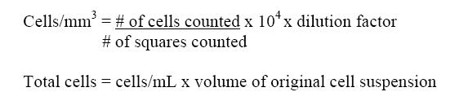
Calculations

Slide 36
Automated Methods
The key issue in using automated counters is to • ensure that the instrument can provide reliable counts at the low levels of cells encountered in
body fluids.
Thus, each laboratory must define the lower limits • for counting nucleated cells and erythrocytes, below which the use of automated or semiautomated
counters is not reliable.
The lower limit for counting should not exceed the • limits recommended by manufacturers.
Automated methods for body fluid analysis offer the • laboratory an alternative to improve the precision of the
results by counting more cells than manual methods.
While the coefficient of variation at low cell counts is high • on automated instruments, it is not nearly as high as
manual cell counts.
There are a number of instruments available to perform •
body fluid cell counting. Depending on the instrument, the
technologies incorporated can include impedance, digital
imaging flow cytometry, flow cytometry, light scatter,
dyes, and fluorescence, or a combination of these
technologies.

Slide 37
Carry-Over
The effect of one sample on the next sample immediately following it • should obviously be minimized.
This is especially true for clear and colorless CSF that may follow a •
bloody CSF.
Any carry-over that may be present should be of no clinical significance • whatsoever.
There are two types of carry-over: •
positive carry-over; and (١ negative carry-over. (٢
Positive carry-over is the effect of an elevated sample on a subsequent • sample of lower concentration.
Negative carry-over is the effect of a low concentration sample on a • subsequent sample of higher concentration.
This condition can be possibly observed in instruments where a dilution •
effect can occur by the diluent/rinsing agent during the rinse cycle that occurs between sample analyses.

Slide 38
QC of automated BF cell count
The College of American Pathologists (CAP)
states that if the same instrument is used for cell counting of blood specimens, there is no need to have separate control runs for body
fluid cell counting
•

Slide 39
Thank you for your attention

